Slide 1
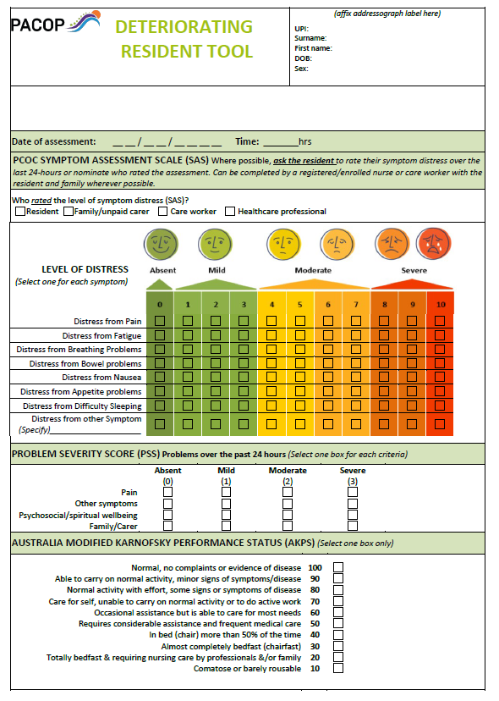
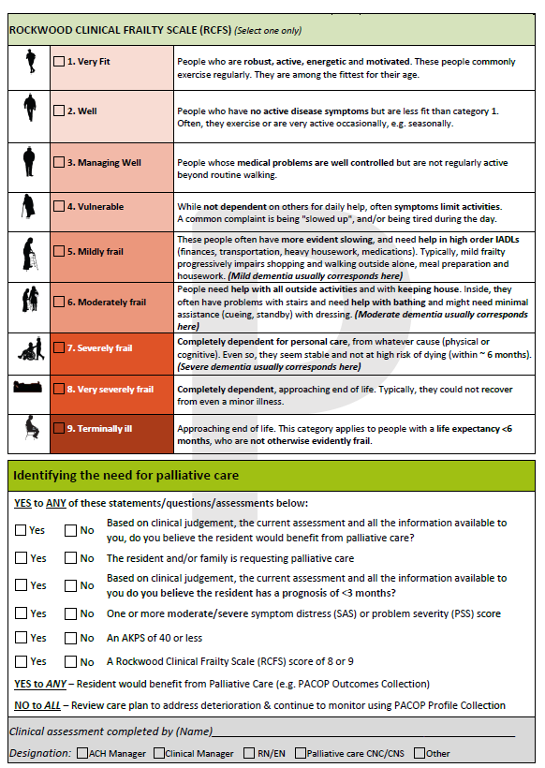
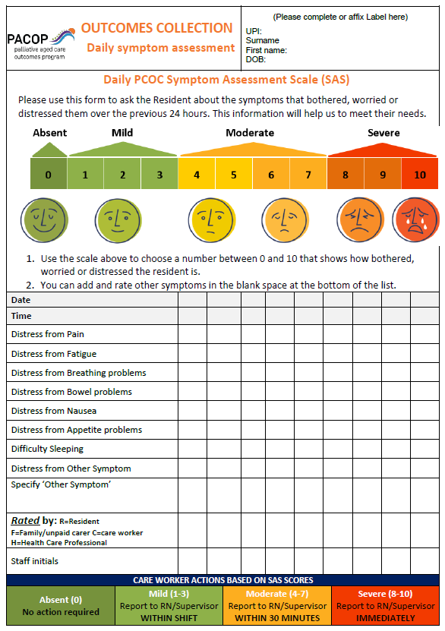
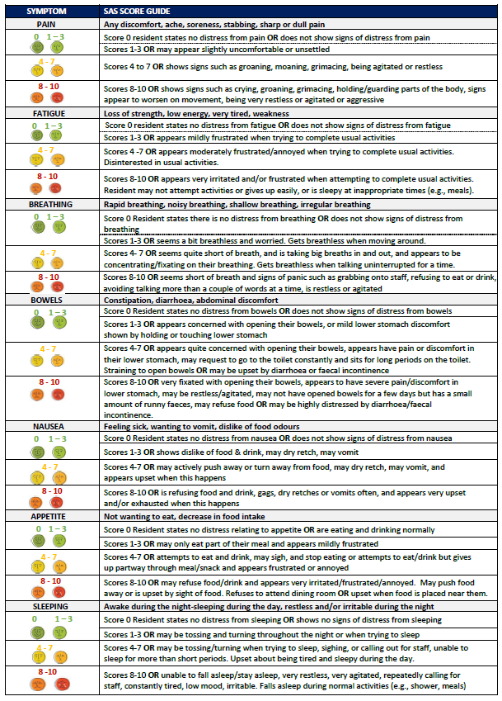
Early identification of palliative care needs in aged care residents
Remember to use the ‘Deteriorating Resident Tool’:
· On admission
· ROD
· Upon return from hospital, ED.
· Changes in the resident observed by any staff member
Remember to use the ‘Daily SAS’ weekly or daily as indicated by the symptom distress rating:
To monitor residents with identified palliative care needs

