Slide 1




Comprehensive Palliative Care in Aged Care Project
A systematic approach to identification and responding to palliative care needs
Presented by Donna Walter – Comprehensive Palliative Care in Aged Care Project Officer

Slide 2
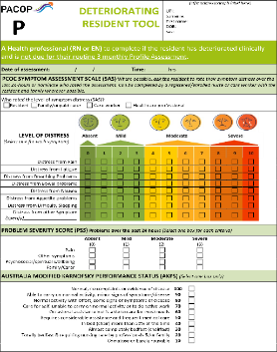
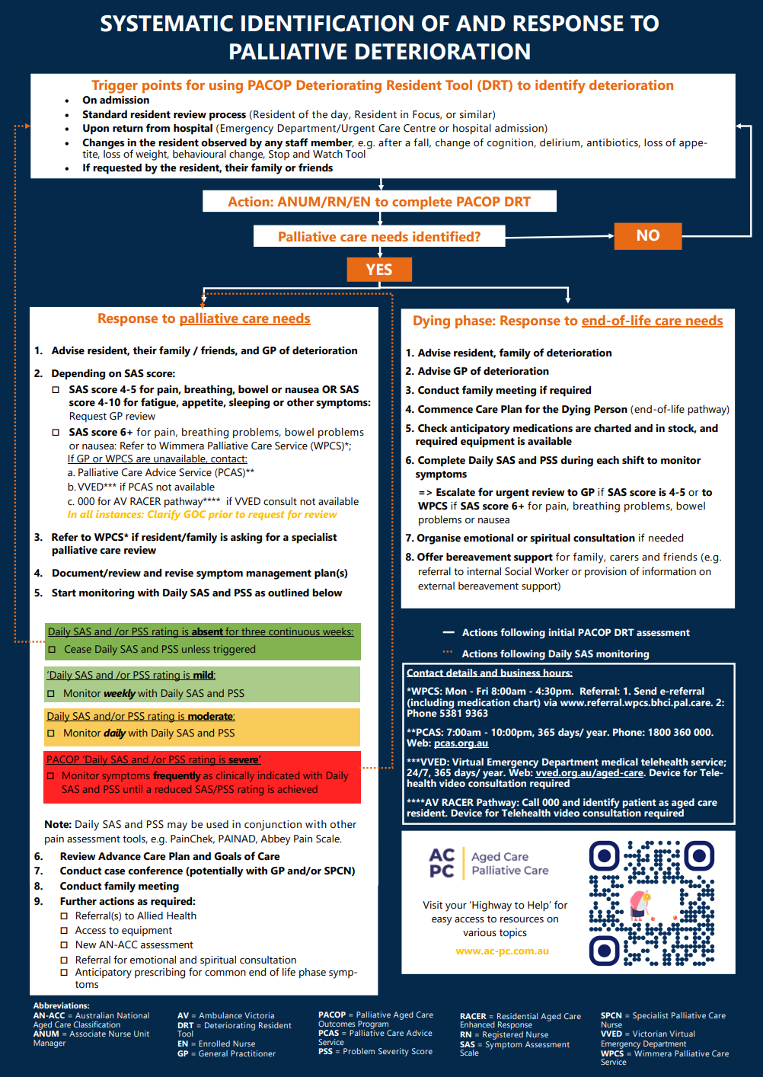
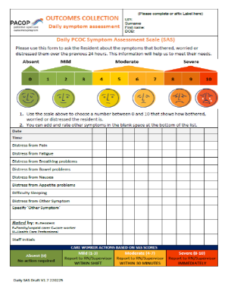

Tools for systematic approach to identifying and responding to palliative care needs
PACOP Deteriorating Resident Tool (DRT) - baseline palliative care needs assessment tool for nurses (RN’s , EN’s).
Facility process map - nurses guide for follow up actions if palliative care needs identified by DRT assessment.
PACOP Daily Symptom Assessment Scale (SAS) - tool for nurses and other care staff for closer monitoring of any symptoms identified as concerning during DRT assessments.

Slide 3
Deteriorating Resident Tool (DRT)
Part of the PACOP ‘profile collection’, baseline assessment tool to identify palliative care needs.
Single form combines evidence-based assessment elements from both palliative care and aged care specialities to identify symptoms and help predict future deterioration.
DRT assessment is aligned to facility’s routine processes, recommended at 4 specific trigger points - admission, resident of the day, return from acute hospital admission –emergency department and anytime there is a change in condition , concern, - alongside acute assessment.
Supports staff to enhance resident wellbeing through early symptom management and timely , meaningful ACP and GoC conversations, guided by regular monitoring of changes.

Slide 4
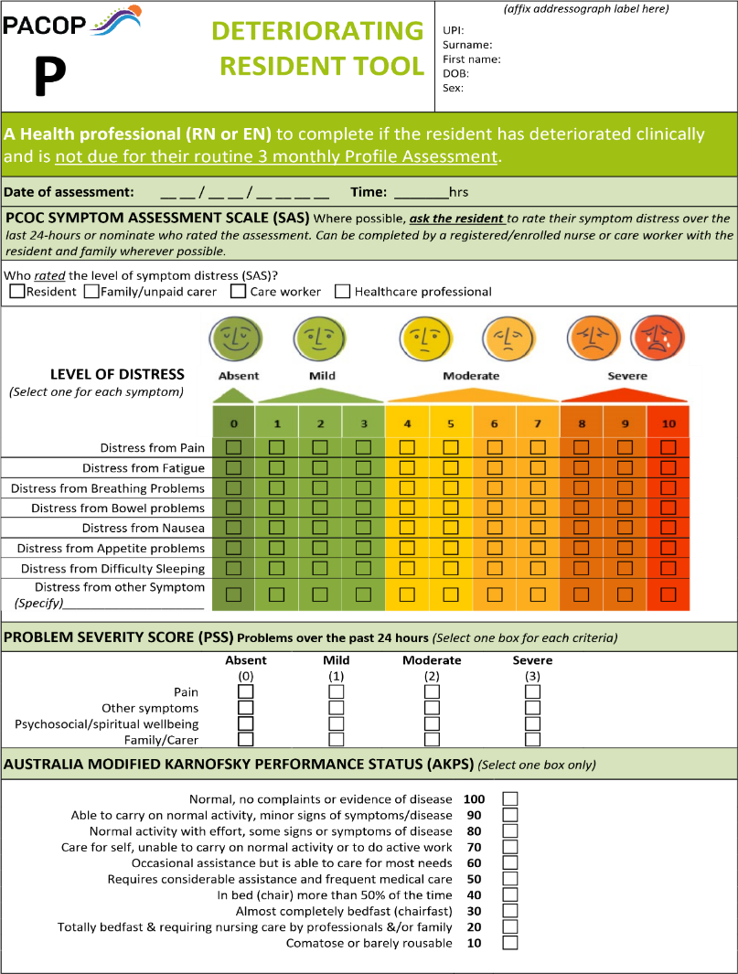
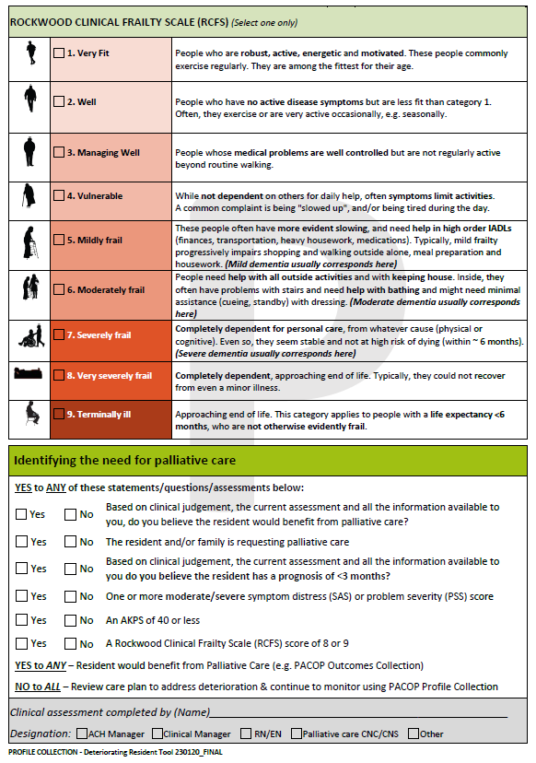

Slide 5
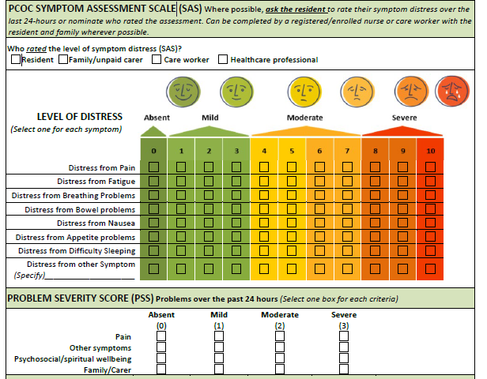
Symptom Assessment Scale (SAS) & Problem Severity Score (PSS)
SAS resident rates level of distress, bother, concern or worry caused by any of common palliative or end-of-life symptoms over the past 24 hrs .
Connect with the resident – ask the questions – does it bother you , upset or worry you ? Proxy may rate if resident is unable rate.
PSS (problem severity score) clinician rates severity of problems in 4 domains over past 24hours , 4 tier rating from absent to severe.
SAS and PSS work together, addressing both resident and clinician concerns.

Slide 6
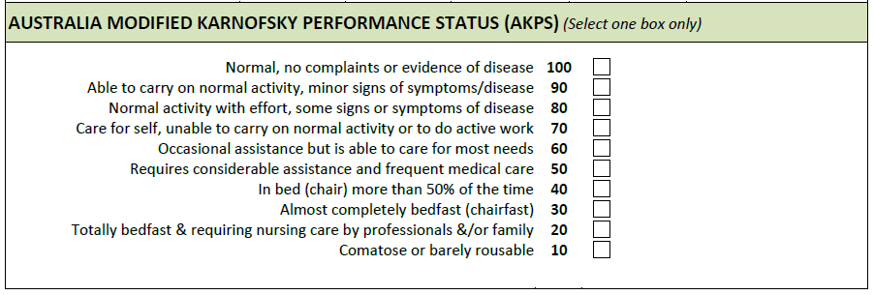
Australia Modified Karnofsky Performance Status (AKPS)
Clinician rated tool – rates overall ability in activities of daily life.
3 specific domains activity, work and self-care.
Observe resident & choose the most accurate score.
Score of 40 - significant turning point to review care palliative care needs.

Slide 7
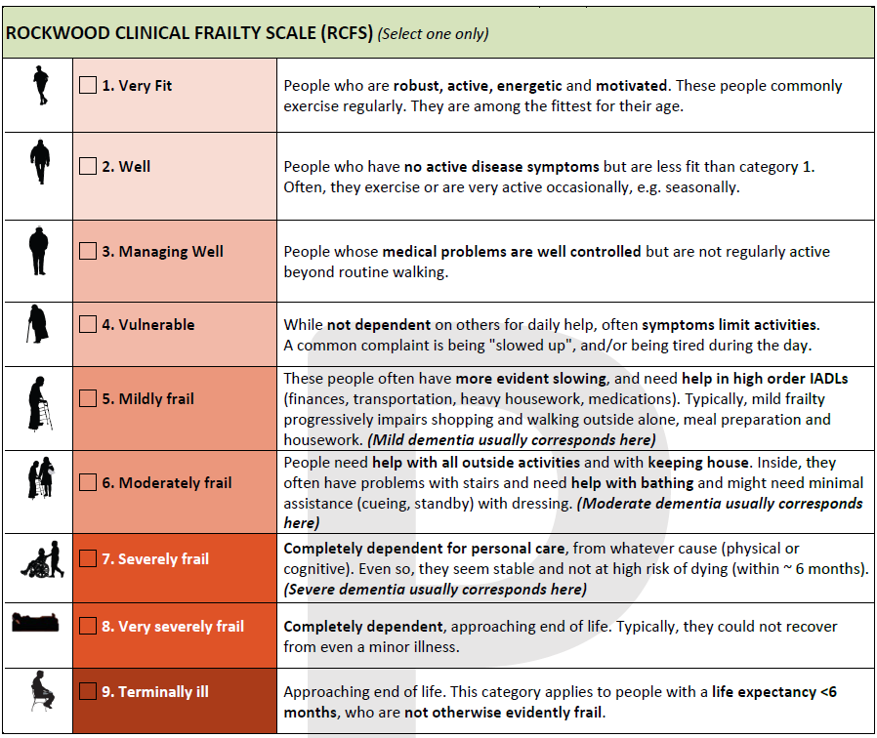
Rockwood Clinical Frailty Scale (RCFS)
Assessment of frailty as a prognostic indicator.
Clinician rated tool assesses physical and cognitive frailty using pictographs and descriptors.
Rates domains of energy ,physical fitness, active disease symptoms, level of dependence, cognitive status (scores 5-7).
Most residents in RAC at end of life will score 8.

Slide 8

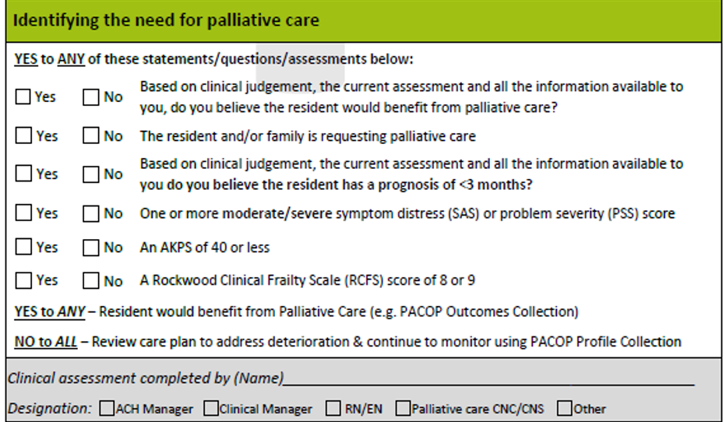
Palliative care needs ?
YES, to ANY refer to facility process map for follow up actions guide
NO to ALL then next DRT assessment at next ROD review unless triggered

Slide 9
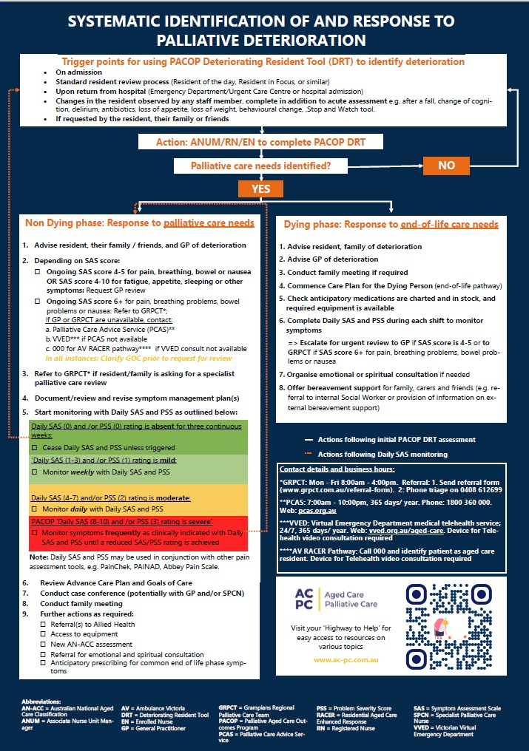
Facility Process Map (FPM)
Pathway for response when palliative care needs identified by DRT assessment. Example GRPCT service area
Clinician follows appropriate pathway response to support quality of life for non dying phase or quality of death for dying phase.
DRT may trigger increased symptom monitoring with Daily SAS ……facility process map guides frequency and duration of monitoring.
Outlines defined triggers for accessing external supports, such as PCAS ,VVED and specialist palliative care services.

Slide 10

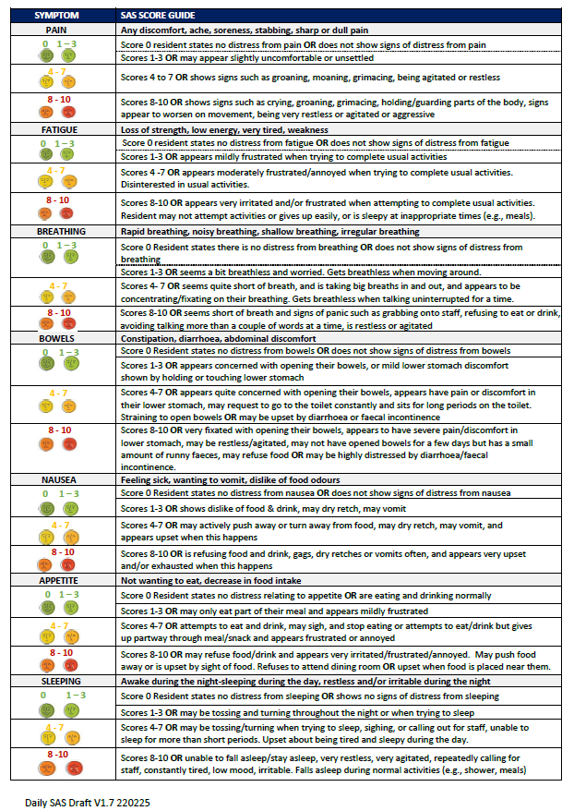
Daily Symptom Assessment Scale (SAS)
Part of the PACOP ‘outcomes collection’ utilised for symptom monitoring when moderate or severe SAS or PSS symptom scores identified during a DRT assessment.
Includes symptom rating descriptors on the reverse of form , helpful when rating as proxy.
Includes guide for urgency of reporting to supervisor aligned to SAS scores.
Follow the process map to guide frequency and duration of SAS monitoring

Slide 11
PACOP Daily SAS

Slide 12

Final tips
Some residents in non-dying phase may repeatedly trigger palliative care needs on ROD DRT assessments but remain stable (AKPS ≤40 or Rockwood 8–9) with no SAS/PSS alerts. Review process map and ensure initial actions are completed, then no further action is required > revert to next DRT assessment at ROD unless triggered earlier.
Use assessment scores in internal communications and with GP’s and external support services i.e. specialist palliative care …encouraging a shared language.’
View PACOP “clinical bites” short videos on the palliative care assessments introduced here and much more via the ACPC link ….. https://ac-pc.com.au/

Slide 13

References
Aged Care Quality and Safety Commission. (2025). Quality Standards. Aged Care Quality and Safety Commission; Australian Government. https://www.agedcarequality.gov.au/providers/quality-standards
Palliative Aged Care Outcomes Program - University of Wollongong – UOW. (2024). Uow.edu.au. https://www.uow.edu.au/australasian-health-outcomes-consortium/pacop/

